Slide 1
Computer Fundamentals and Computing software
Prof. Amandeep Kaur
S . D. College Hoshiarpur
Department of Computers

Slide 2
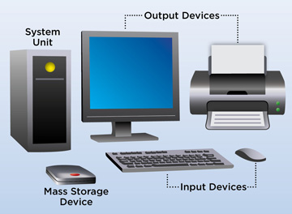
What is Computer?
A computer is an electronic data processing device, which accepts and stores data input, processes the data input, and generates the output in a required format.

Slide 3
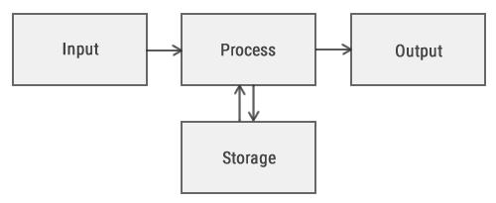
Functionalities of a Computer If we look at it in a very broad sense, any digital computer carries out the following five functions − Step 1 − Takes data as input. Step 2 − Stores the data/instructions in its memory and uses them as required. Step 3 − Processes the data and converts it into useful information. Step 4 − Generates the output. Step 5 − Controls all the above four steps.

Slide 4
Characteristics of Computer
High Speed
Computer is a very fast device.
It is capable of performing calculation of very large amount of data.
The computer has units of speed in microsecond, nanosecond, and even the picosecond.
It can perform millions of calculations in a few seconds as compared to man who will spend many months to perform the same task.
Accuracy
In addition to being very fast, computers are very accurate.
The calculations are 100% error free.
Computers perform all jobs with 100% accuracy provided that the input is correct.

Slide 5
Characteristics of Computer
Storage Capability
Memory is a very important characteristic of computers.
A computer has much more storage capacity than human beings.
It can store large amount of data.
It can store any type of data such as images, videos, text, audio, etc.
Diligence
Unlike human beings, a computer is free from monotony, tiredness, and lack of concentration.
It can work continuously without any error and boredom.
It can perform repeated tasks with the same speed and accuracy.

Slide 6
Characteristics of Computer
Versatility
A computer is a very versatile machine.
A computer is very flexible in performing the jobs to be done.
This machine can be used to solve the problems related to various fields.
At one instance, it may be solving a complex scientific problem and the very next moment it may be playing a card game.
Reliability
A computer is a reliable machine.
Modern electronic components have long lives.
Computers are designed to make maintenance easy.

Slide 7
Characteristics of Computer
Automation
Computer is an automatic machine.
Automation is the ability to perform a given task automatically. Once the computer receives a program i.e., the program is stored in the computer memory, then the program and instruction can control the program execution without human interaction.
Reduction in Paper Work and Cost
The use of computers for data processing in an organization leads to reduction in paper work and results in speeding up the process.
As data in electronic files can be retrieved as and when required, the problem of maintenance of large number of paper files gets reduced.
Though the initial investment for installing a computer is high, it substantially reduces the cost of each of its transaction.

Slide 8
Disadvantages of Computers
No I.Q.
A computer is a machine that has no intelligence to perform any task.
Each instruction has to be given to the computer.
A computer cannot take any decision on its own.
Dependency
It functions as per the user’s instruction, thus it is fully dependent on humans.
No Feeling
Computers have no feelings or emotions.
It cannot make judgment based on feeling, taste, experience, and knowledge unlike humans.

Slide 9
Applications
Business
A computer has high speed of calculation, diligence, accuracy, reliability, or versatility which has made it an integrated part in all business organizations.
Computer is used in business organizations for −
Payroll calculations
Sales analysis
Financial forecasting
Managing employee database
Maintenance of stocks, etc.

Slide 10
Banking
Today, banking is almost totally dependent on computers.
Banks provide the following facilities −
Online accounting facility, which includes checking current balance, making deposits and overdrafts, checking interest charges, shares, and trustee records.
ATM machines which are completely automated are making it even easier for customers to deal with banks.

Slide 11
Insurance
Insurance companies are keeping all records up-to-date with the help of computers. Insurance companies, finance houses, and stock broking firms are widely using computers for their concerns.
Insurance companies are maintaining a database of all clients with information showing −
Procedure to continue with policies
Starting date of the policies
Next due installment of a policy
Maturity date
Interests due
Survival benefits
Bonus

Slide 12
Education
The computer helps in providing a lot of facilities in the education system.
The computer provides a tool in the education system known as CBE (Computer Based Education).
CBE involves control, delivery, and evaluation of learning.
Computer education is rapidly increasing the graph of number of computer students.
There are a number of methods in which educational institutions can use a computer to educate the students.
It is used to prepare a database about performance of a student and analysis is carried out on this basis.

Slide 13
Following are some other fields where computer is used:-
Health Care
Engineering
Communication
Government

